Slide 1
Crafting & Compelling Website Analysis, Audit and Recommendations
Presented by
Dhivya M – MBE11

Slide 2
Task -1: Company selection
I have selected TCS for this project work.
Tata Consultancy Services (TCS) is an Indian multinational technology company specializing in information technology services and consulting.
TCS, a global leader in IT services, consulting, and business solutions, leverages technology for business transformation and helps catalyze change.
TCS has 41 offices in 14 cities of India.
As a leader in innovation and transformation, TCS offers a range of services to enterprises, working with them to build better futures.

Slide 3
Task – 2: Products and services
TCS provides 15 services such as Artificial Intelligence, cloud, Data Analytics, cybersecurity, consulting etc.
1. Artificial Intelligence:
This service uses advanced AI technologies to help businesses enhance efficiency, drive innovation, and improve decision-making.
It offers a range of solutions, including machine learning, natural language processing, and data analytics, tailored to meet specific industry needs.
TCS AI WisdomNext™ is a platform that aggregates multiple generative AI (GenAI) and cloud services into a unified interface.
2. Cloud services:
This Services provide comprehensive cloud solutions to help businesses accelerate their digital transformation. Offering a range of services—from cloud strategy and migration to management and optimization.
TCS enables organizations to leverage the scalability, flexibility, and cost-effectiveness of the cloud.
TCS Enterprise Cloud offers a gamut of flexible, end-to-end full-stack cloud options with robust modernization capabilities .

Slide 4
3. Data Analytics:
TCS Data Analytics services empower organizations to harness the power of data for informed decision-making and strategic insights.
By utilizing advanced analytics techniques, machine learning, and visualization tools, TCS helps businesses uncover patterns, trends, and actionable insights from their data.
TCS Datom, Daezmo, Dexam are some of the platforms used for Data Analytics.
4. Cybersecurity:
This service offer comprehensive solutions to protect organizations from evolving cyber threats.
With a focus on risk management, threat detection, and incident response, TCS employs advanced technologies and best practices to safeguard critical assets and data.
Their services include security assessments, compliance management, and continuous monitoring, helping businesses build resilient security frameworks.
5. Consulting:
This service provide strategic guidance to organizations seeking to navigate complex business challenges and drive transformation.
They collaborate with clients to develop tailored solutions that enhance operational efficiency, optimize processes, and leverage technology effectively.
Their expertise spans areas such as digital transformation, business strategy, and change management

Slide 5
Task – 3: Website Platform Identification
TCS website is built using JavaScript found using seranking.com and confirmed by referring with the source code.
Adobe Experience Manager is the content management system (CMS) used in this site.
This website uses Apache Web server.

Slide 6
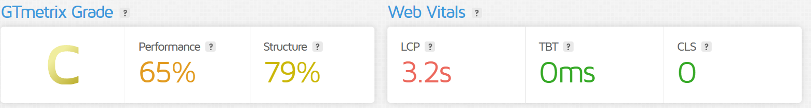
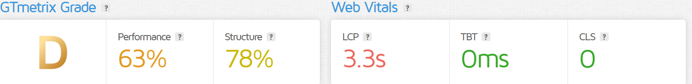
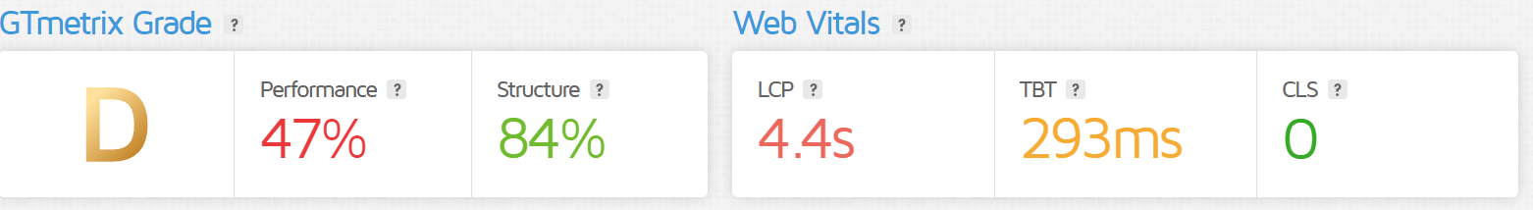
Task – 4: Responsive design Testing
This test is done using https://gtmetrix.com/
https://www.tcs.com/
https://www.tcs.com/what-we-do/services/artificial-intelligence
https://www.tcs.com/what-we-do/services/cloud

Slide 7
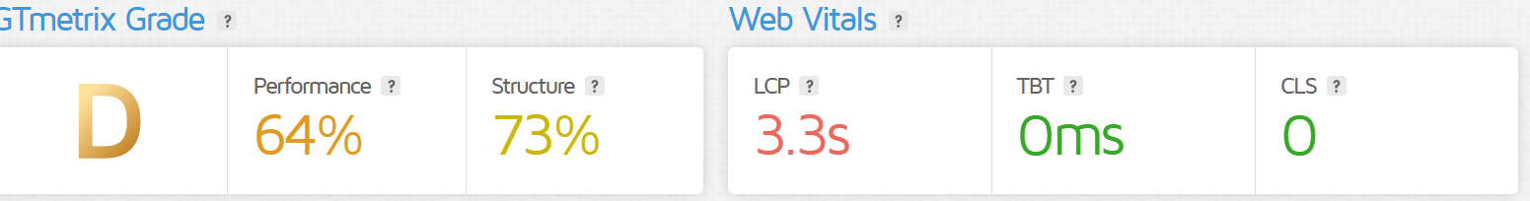
https://www.tcs.com/what-we-do/services/cybersecurity
https://www.tcs.com/what-we-do/services/consulting

Slide 8
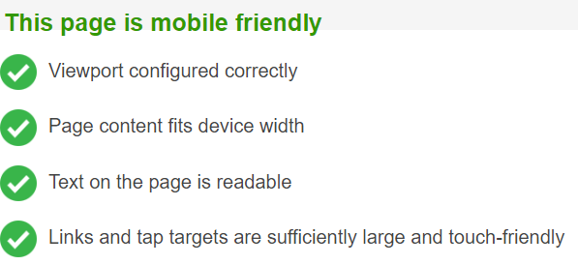
Mobile optimization
All the five pages taken for responsive design testing is also tested for Mobile optimization and the report is shared below. Tested using https://www.bing.com/webmaster/tools/mobile-friendliness.

Slide 9
Task -5: Website Mistakes Identification
Importance has to be given into reducing JavaScript, reducing web-fonts, and image optimization to ensure a lightweight and streamlined website.
Large network payloads cost users real money and are highly correlated with long load times. Enormous network payloads should be avoided.
A large DOM will increase memory usage, cause longer style calculations, and produce costly layout reflows. So excessive DOM size should be avoided.
Set an explicit width and height on image elements to reduce layout shifts and improve CLS.
A long cache lifetime can speed up repeat visits to your page. Serve static assets with an efficient cache policy.

Slide 10
Task – 6: Best Practices
Prioritize User Experience
(UX)User-Centered Design: Understand your target audience and design based on their needs and preferences.
Responsive Design: Ensure your website works well on all devices, from desktops to mobile phones.
Maintain Consistency
Visual Hierarchy: Use size, color, and spacing to guide users’ attention to key elements.
Consistent Branding: Use the same colors, fonts, and styles throughout to reinforce brand identity.
Focus on Performance
Fast Load Times: Optimize your site to load quickly to enhance user satisfaction.
Minimalist Design: Avoid excessive elements that can slow down the site.

Slide 11
Use High-Quality Images
Relevant Visuals: Choose images that support your content and enhance the user experience.
Optimize for Speed: Compress images to improve load times without sacrificing quality.
Incorporate Feedback Mechanisms
User Testing: Regularly gather feedback from users to identify pain points and improve usability.
Analytics Tracking: Use tools to monitor user behavior and make data-driven design decisions.

Slide 12
Task-7 : Landing Page Design:
I have created a Digital Marketing agency Landing page using Canva. The Website link is as follow
https://halcyon-marketing.my.canva.site/

Slide 13
Thank you

